Slide 1
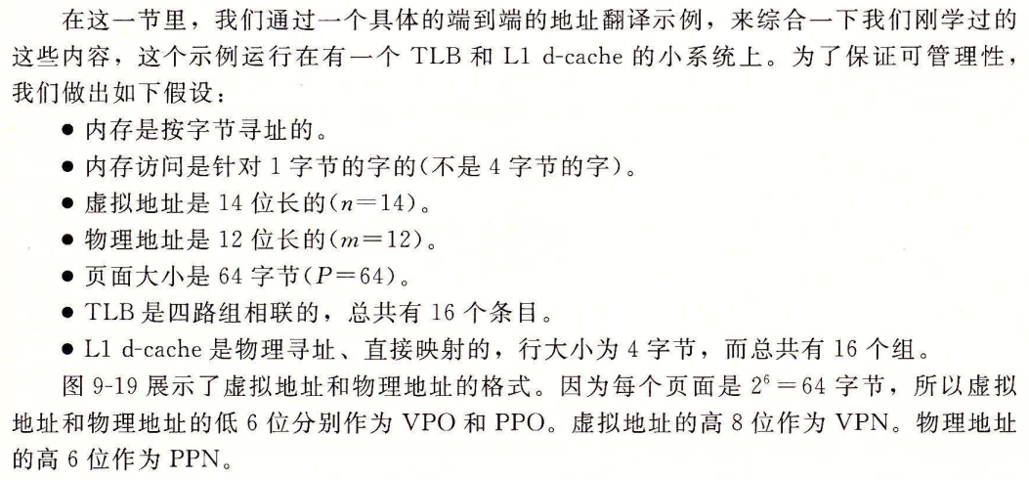
CSAPP 3e 9.6.4

Slide 2
Addressing
14-bit virtual addresses
12-bit physical address
Page size = 64 bytes（6 bits）
256 PTEs（8 bits VPN）
13
12
11
10
9
8
7
6
5
4
3
2
1
0
VPN
VPO
Virtual Page Number
Virtual Page Offset
11
10
9
8
7
6
5
4
3
2
1
0
PPN
PPO
Physical Page Number
Physical Page Offset

Slide 3
TLB
16 entries
4-way associative
TLBT
TLBI
13
12
11
10
9
8
7
6
5
4
3
2
1
0
VPN
VPO
Set
Tag
PPN
Valid
Tag
PPN
Valid
Tag
PPN
Valid
Tag
PPN
Valid
0
03
–
0
09
0D
1
00
–
0
07
02
1
1
03
2D
1
02
–
0
04
–
0
0A
–
0
2
02
–
0
08
–
0
06
–
0
03
–
0
3
07
–
0
03
0D
1
0A
34
1
02
–
0

Slide 4
Page Table
Only show first 16 entries (out of 256)
VPN
PPN
Valid
VPN
PPN
Valid
00
28
1
08
13
1
01
–
0
09
17
1
02
33
1
0A
09
1
03
02
1
0B
–
0
04
–
0
0C
–
0
05
16
1
0D
2D
1
06
–
0
0E
11
1
07
–
0
0F
0D
1

Slide 5
Cache
Physically addressed
Direct mapped
16 lines, 4-byte block size
CT
CI
CO
11
10
9
8
7
6
5
4
3
2
1
0
PPN
PPO
Idx
Tag
Valid
B0
B1
B2
B3
Idx
Tag
Valid
B0
B1
B2
B3
0
19
1
99
11
23
11
8
24
1
3A
00
51
89
1
15
0
–
–
–
–
9
2D
0
–
–
–
–
2
1B
1
00
02
04
08
A
2D
1
93
15
DA
3B
3
36
0
–
–
–
–
B
0B
0
–
–
–
–
4
32
1
43
6D
8F
09
C
12
0
–
–
–
–
5
0D
1
36
72
F0
1D
D
16
1
04
96
34
15
6
31
0
–
–
–
–
E
13
1
83
77
1B
D3
7
16
1
11
C2
DF
03
F
14
0
–
–
–
–

Slide 6
Address Translation
Virtual Address: 0x03D4 0x030F 0x0020
VPN ___ TLBI ___ TLBT ____ TLB Hit? __ Page Fault? __ PPN: ____
Physical Address
CO ___ CI___ CT ____ Hit? __ Byte: ____

Slide 7
Address Translation Example #1
Virtual Address: 0x03D4
VPN ___ TLBI ___ TLBT ____ TLB Hit? __ Page Fault? __ PPN: ____
Physical Address
CO ___ CI___ CT ____ Hit? __ Byte: ____
TLBT
TLBI
13
12
11
10
9
8
7
6
5
4
3
2
1
0
0
0
0
0
1
1
1
1
0
1
0
1
0
0
VPN
VPO
0x0F
0x3
0x03
Y
N
0x0D
CT
CI
CO
11
10
9
8
7
6
5
4
3
2
1
0
0
0
1
1
0
1
0
1
0
1
0
0
PPN
PPO
0
0x5
0x0D
Y
0x36

Slide 8
Address Translation Example #2
Virtual Address: 0x030F
VPN ___ TLBI ___ TLBT ____ TLB Hit? __ Page Fault? __ PPN: ____
Physical Address
CO ___ CI___ CT ____ Hit? __ Byte: ____
TLBT
TLBI
13
12
11
10
9
8
7
6
5
4
3
2
1
0
0
0
0
0
1
1
0
0
0
0
1
1
1
1
VPN
VPO
0x0C
0
0x03
N
Y
CT
CI
CO
11
10
9
8
7
6
5
4
3
2
1
0
PPN
PPO

Slide 9
Address Translation Example #3
Virtual Address: 0x0020
VPN ___ TLBI ___ TLBT ____ TLB Hit? __ Page Fault? __ PPN: ____
Physical Address
CO___ CI___ CT ____ Hit? __ Byte: ____
TLBT
TLBI
13
12
11
10
9
8
7
6
5
4
3
2
1
0
0
0
0
0
0
0
0
0
1
0
0
0
0
0
VPN
VPO
0x00
0
0x00
N
N
0x28
CT
CI
CO
11
10
9
8
7
6
5
4
3
2
1
0
1
0
1
0
0
0
1
0
0
0
0
0
PPN
PPO
0
0x8
0x28
N
Mem

